Slide 1
MY DATA CLEANING CHALLENGE PRISCILLA CHINGAMTOLO
MARCH 2023

Slide 2
Introduction
This is a detailed report on the Data Cleaning Challenged organised by @PromiseNonso_ and @VicSomadina
The initiative started to encourage people to keep their skills in data space relevant and learn other ideas. Understanding the necessity of data cleaning in as far as data analysis and reporting is concerned, participants got seriously engaged in the exercise to ensure that the messy raw data provided got fixed by removing incorrect, incorrectly formatted, duplicate, or incomplete data within the dataset.
Tool used – Power Query Editor
Data source – FIFA 21 raw dataset https://www.kaggle.com/datasets/yagunnersya/fifa-21-messy-raw-dataset-for-cleaning-exploring
The data set contains 18,979 rows and 77 columns

Slide 3
Purpose and Specific Objectives
To ensure that data is valid and is usable for analysis
Specific objectives
- Identify issues/irregularities within the dataset
- Work on the issues by applying the necessary procedure
- Build insights from the cleaned dataset

Slide 4
Approach
After a quick scan through the dataset, issues/irregularities were observed that needed to be tackled like incorrect data types, unnecessary special characters, inconsistent units for values in columns like cm, feet and inches in the same column
The columns that were cleaned are; Name, Age, OVA, POT, Contract, Height, Weight, Joined, Loan End Date, Value, Wage, Release Clause, W/F, SM, IR and Hits
Some new columns were also added to add meaning that would aid visualisation like Contract period

Slide 5
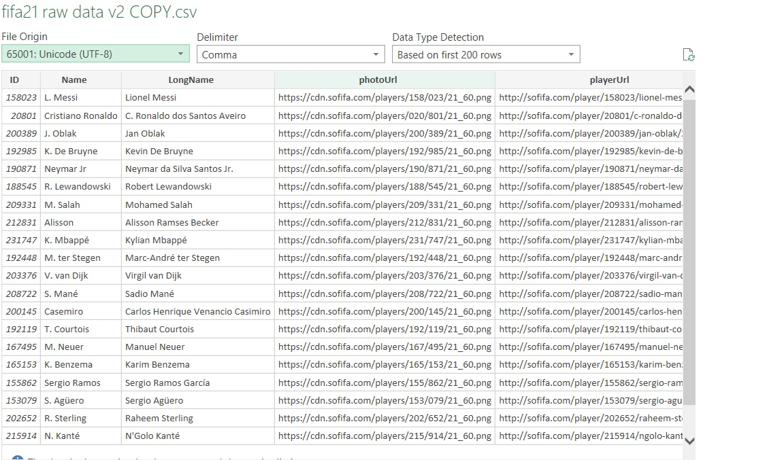
Data Importation
Procedure
I opened Excel
On the data Icon/ribbon, I clicked on Get Data then select from file, I chose CSV which took me to where the dataset was
I selected the file of interest, and it took me to Power Query Editor
Ensured file format was UTF-8 then pressed ‘load’
Special characters in the dataset were removed and replaced with real characters

Slide 6
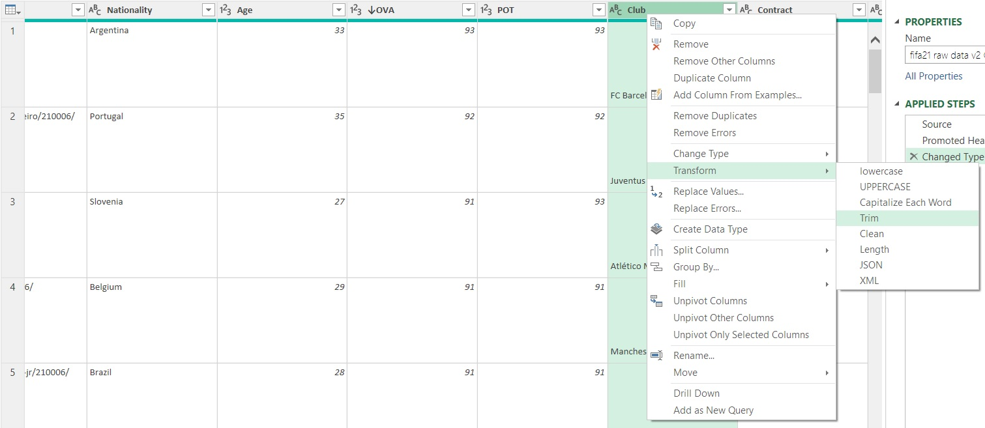
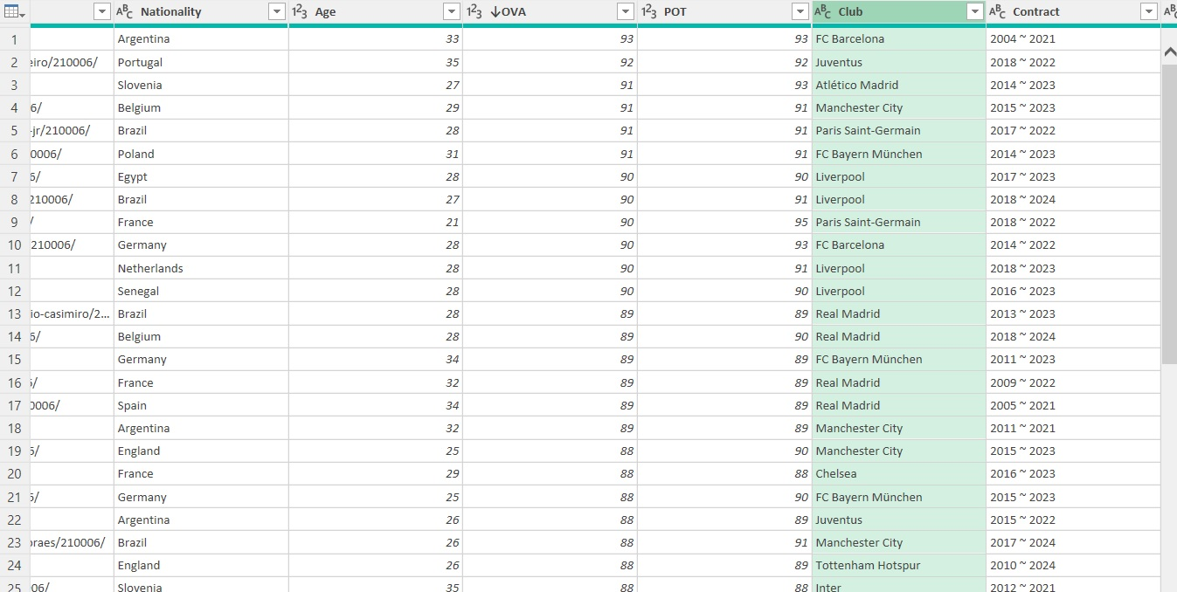
Data Cleaning, Analysis & Visualisation
General cell sizes/Removing white spaces
Cells had bigger sizes, I scanned through the dataset to check the column which affected the sizes. Club column was not rightly aligned like the other columns. The data was transformed by highlighting the Club column, right clicking it, chose Transform then clicked “Trim” which made the cell sizes to have reduced sizes.

Slide 7
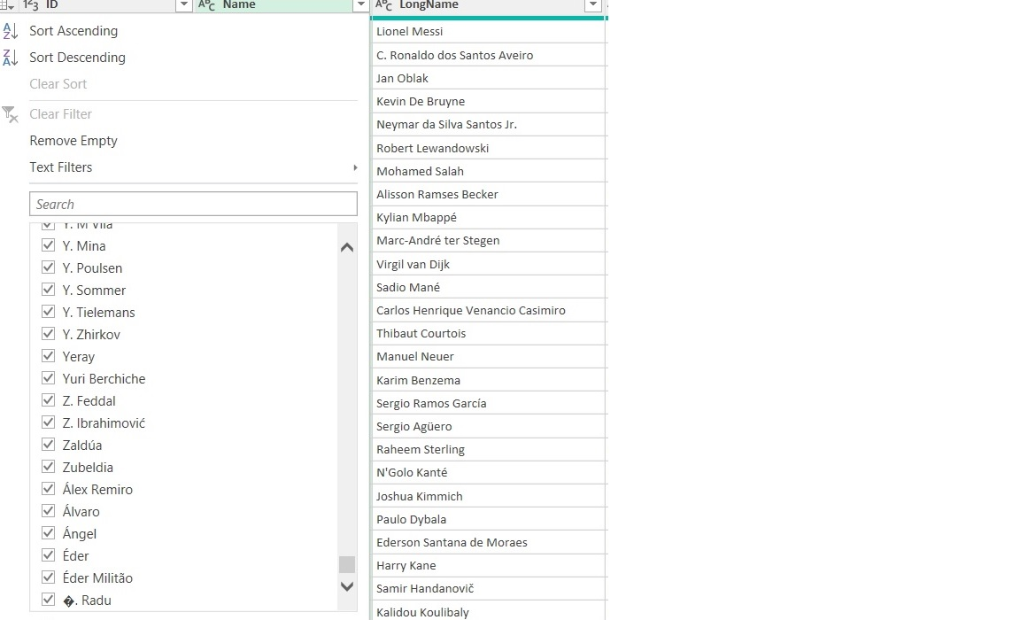
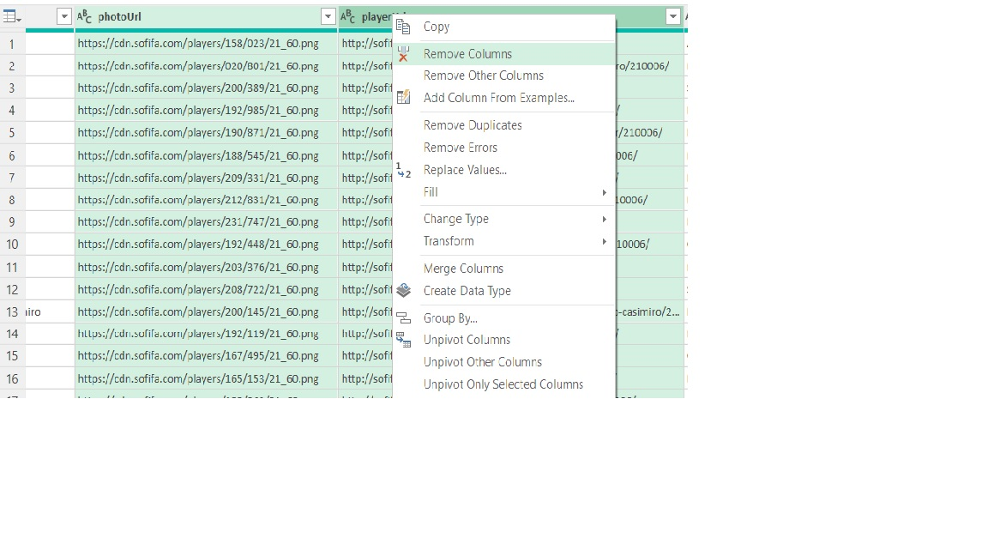
Name column
Noted a symbol present on one of the names which was not supposed to be there. Replaced it with the right letter
Dropped photurl and playerurl as these would not be needed for visualisation

Slide 8
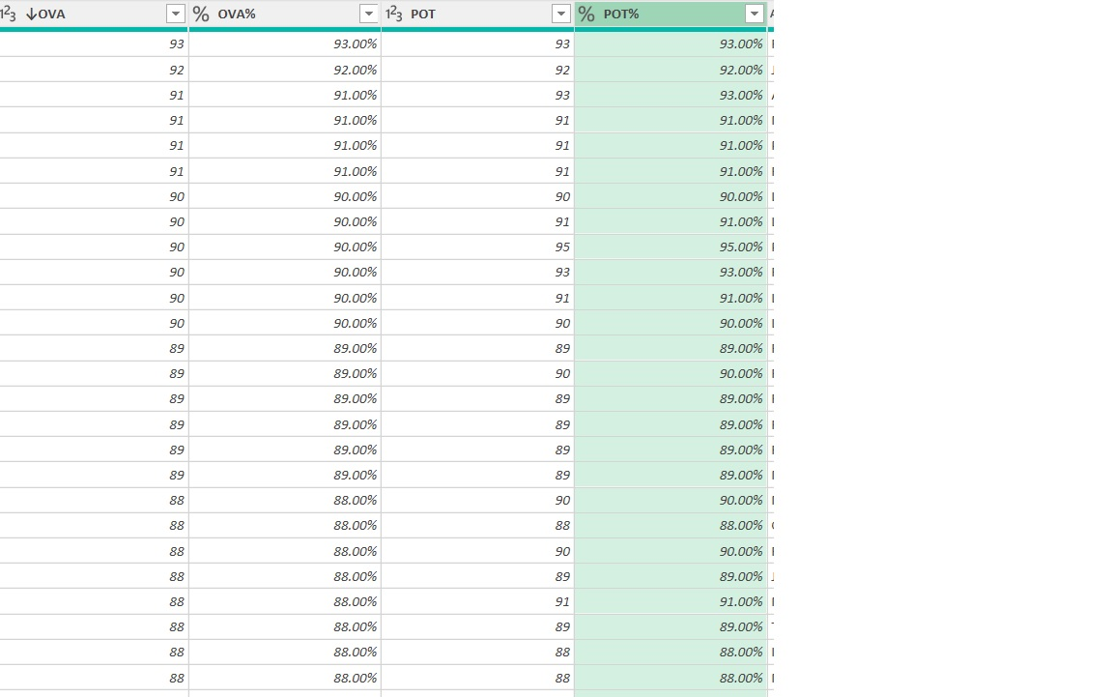
OVA & POT
According to the dictionary, these needed to be in percentage. To achieve this, column from example was used then changed the data type to percentage and reordered the columns to be at their right positions

Slide 9
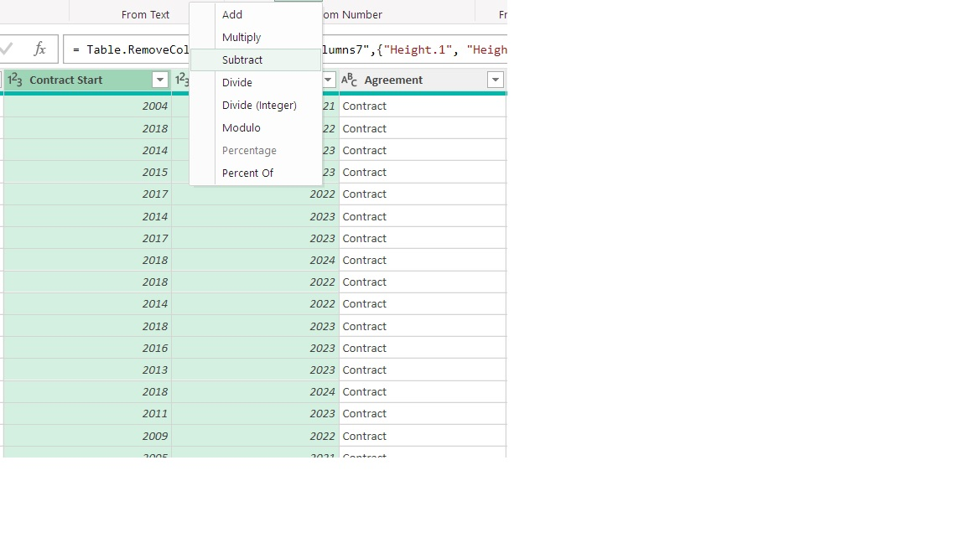
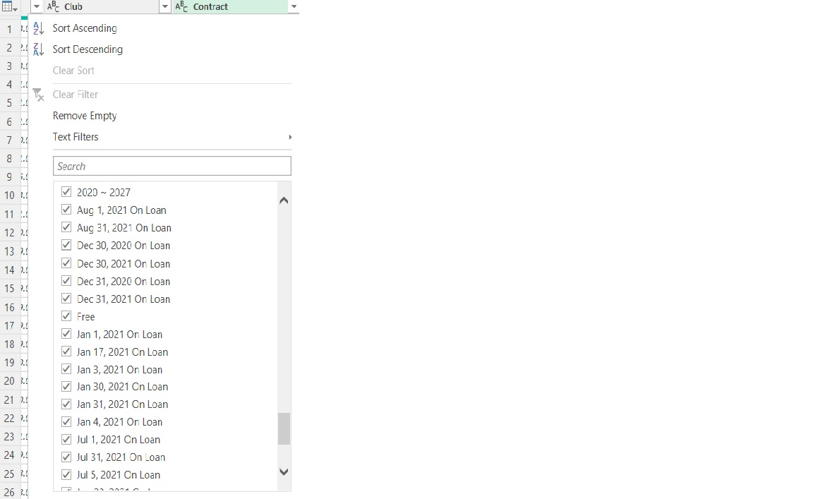
Contract
- Data type and format were not consistent in this column. To sort this, split column was used to give separate information on the start and end year of the contract..

Slide 10
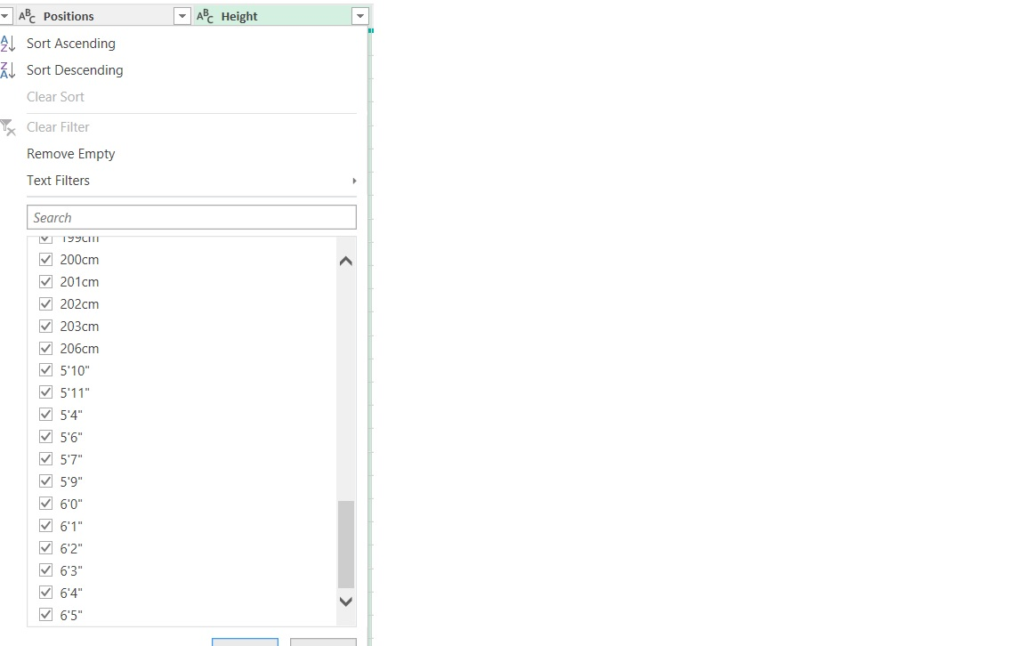
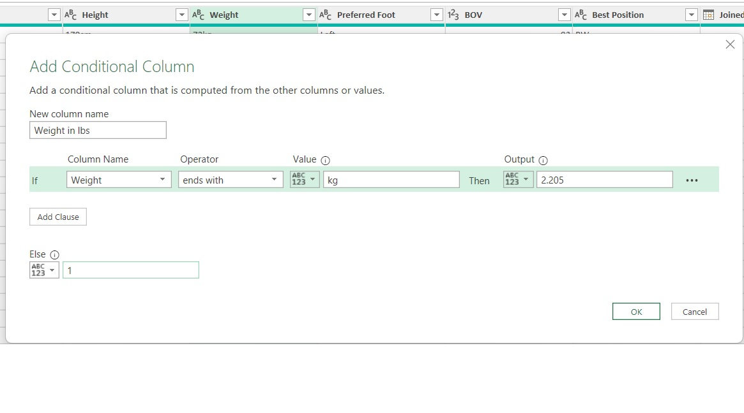
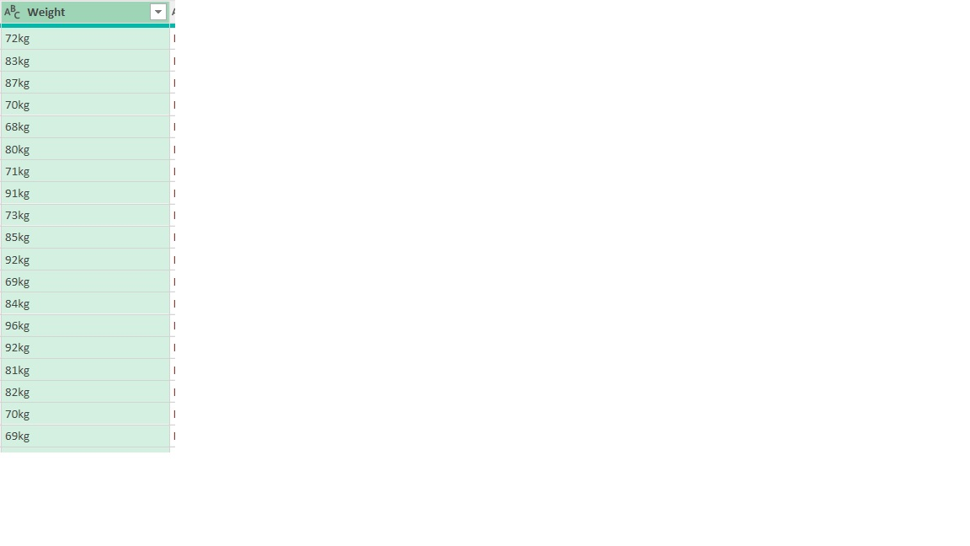
Height
Values had different units like cm, feet and inches. Since these are three different units and that the column needed to have one unit, the columns were split. The cm text value was removed, the feet values multiplied by 30.48 and inches by 2.54 to get them to cm. Addition was later applied so that the Height column had one reporting unit.
Weight
Just like height, weight column had different measuring units, kgs and lbs. to convert the values to lbs, conditional formatting was used and the values in kgs were multiplied by 2.205 which is a standard conversion rate.

Slide 11
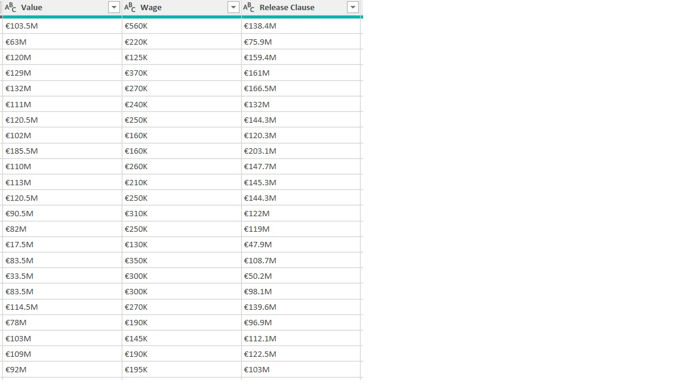
Value, Wage, Release clause and Hits
- These columns had common issues, having the currency (Euro) that needed changing to dollar, the figures were shortened with M for Million and K for Thousand. Using the replace value and conditional formatting table, the symbol/letters were removed, figures multiplied by 1,000,000 and 1,000 as necessary for each row.

Slide 12
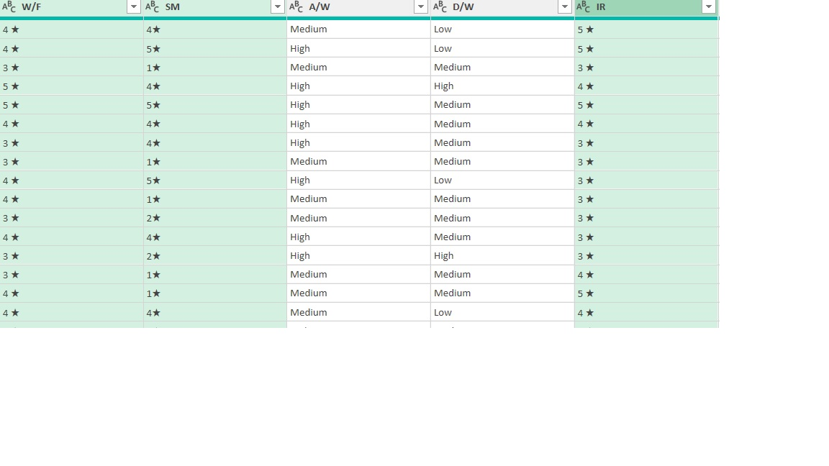
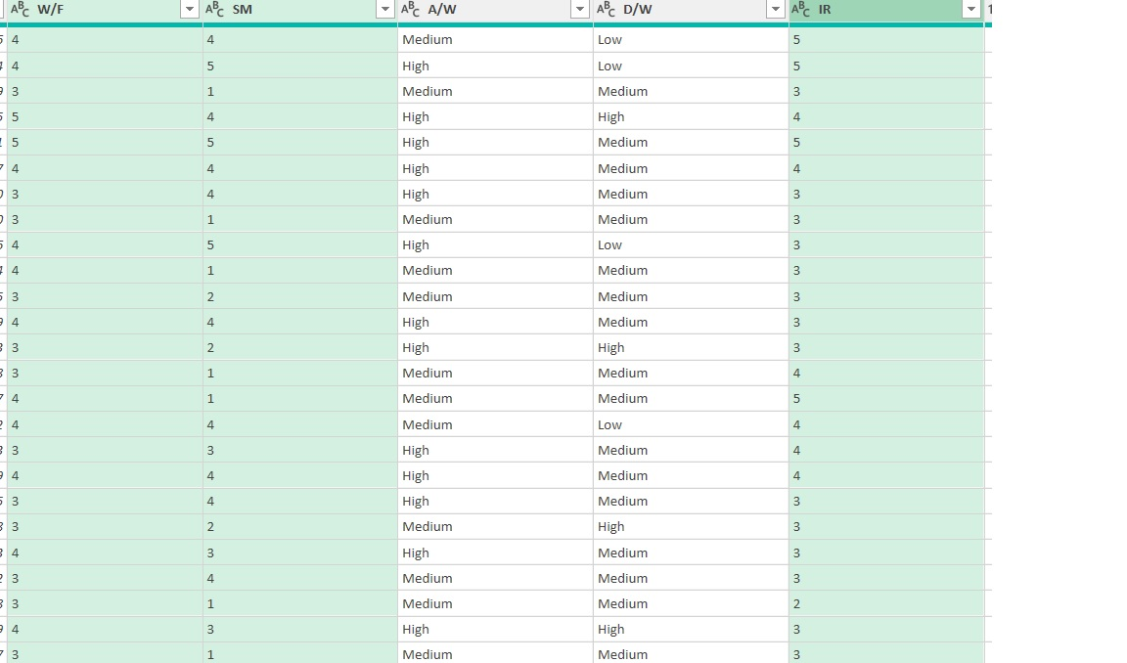
W/F, SM and IR
- Having noted the star symbols in these columns, replace values button was used to remove them.

Slide 13
Insights
The added column showing Period of Contract gives an idea of the player who had the longest contract (23years)

Slide 14
Challenges, Conclusion &Recommendation
Participation in this data challenge exercise has helped me shape my skills.
I was bale to learn new things, adding to my growth
I have been able to make new connections which I believe will last and remain beneficial
It has also been an eye opener on how serious one’s effort is needed when handling tasks like these
I recommend continuation of tasks like these as some people feel lazy to do them on their own, but they get encouraged when done with others
the challenge I experienced was not being able to view other announcements on the Telegram Group due to an outdated app used. Updating the App was not possible, it kept declining.

